Slide 1
W4153 – Cloud Computing Lecture 1: Introduction, Concepts
© Donald F. Ferguson, 2024

Slide 2
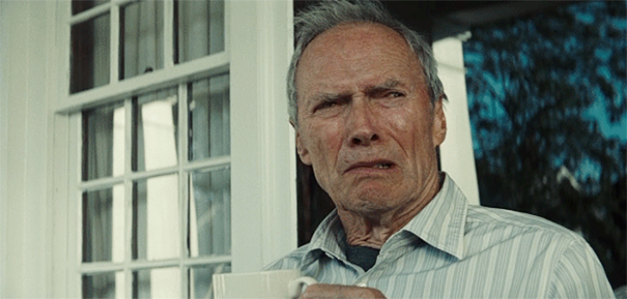
W4153 – Cloud Computing Lecture 1: Introduction, Concepts
We will start in a few minutes.
If you ask me about the waitlist, I will become very grumpy.
© Donald F. Ferguson, 2024

Slide 3

W4111 Introduction to Databases:
Faculty do not manage waitlists for some courses, including W4153.
The academic admin staff in the CS Department manages the waitlist, priorities and enrollment.
You should contact advising email:
ug-advising, ms-advising, or phd-advising @cs.columbia.edu
3 | W4153-24F-L1-Introduction-Concepts © Donald F. Ferguson, 2024

Slide 4
Contents
4 | W4153-24F-L1-Introduction-Concepts © Donald F. Ferguson, 2024

Slide 5
Contents
Course Overview
About your instructor.
Course objectives, logistics, structure, grading, … …
Core Concepts
Cloud computing concepts.
Full stack web application.
An aside on modeling.
Microservices.
Application development concepts.
Sprint 0 – Get Ready for the Remainder of the Course
Form teams.
Individual end-to-end project to validate that you are ready for the coursework.
Discussion, Questions, “Lab”

Slide 6
Course Overview
6 | W4153-24F-L1-Introduction-Concepts © Donald F. Ferguson, 2024

Slide 7
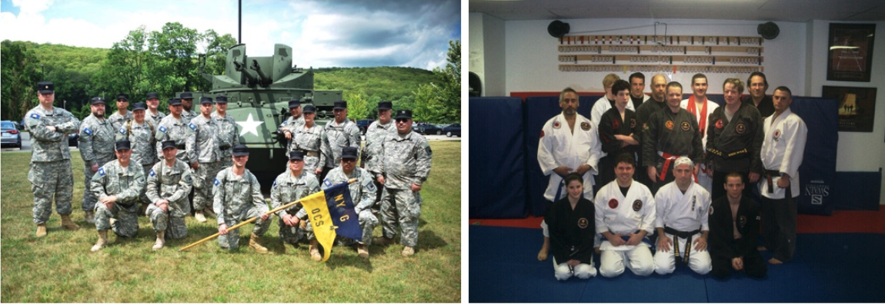
About your Instructor
38 years in computer science industry:
IBM Fellow.
Microsoft Technical Fellow.
Chief Technology Officer, CA technologies.
Dell Senior Technical Fellow.
CTO, Co-Founder, Seeka.tv.
Ansys (current):
Ansys Fellow, Chief SW Architect;
Lead development on cloud, platform, solutions and Autonomous Vehicles/Advanced Driver Assistance Systems
Academic experience:
BA, MS, Ph.D., Computer Science, Columbia University.
Approx. 18 semesters as an Adjunct Professor.
Professor of Professional Practice in CS (2018)
Courses:
E1006: Intro. to Computing
W4111: Intro. to Databases
E6998, E6156: Advanced Topics in SW Engineering (Cloud Computing)
Approx. 65 technical publications; Approx. 12 patents.
Personal:
Two children:
College Sophomore.
2019 Barnard Graduate.
Hobbies:
Krav Maga, Black Belt in Kenpo Karate.
Former 1LT, New York Guard.
Bicycling.
Astronomy.
Languages:
Proficient in Spanish.
Learning Arabic.
I have taught some version of this class 10 times.

Slide 8
Logistics and Grading
Logistics
Lectures: Friday’s 1:10 to 3:40 PM
I can present and cover material much more quickly than you can “use and implement.” ➔
1:10 to 2:50-ish will be lecture and presenting/teaching material.
2:50-ish to 3:40 will be “in the lecture room ‘labs’” where you can work on projects, ask questions, discuss details.
I will periodically devote a lecture slot to extended offices hours, project team meetings, etc.
Office Hours: Friday’s 8:30 AM to 10:00 AM and 4:00 PM to 5:00 PM.
A total of 100 points is available:
Your final team project earns up to 75 points.
Written individual homework assignments earn up to 25 points.
Earning an A+ requires the TAs and my seeing and recognizing individual extra effort that we reward with extra-credit. We will let you know when we assign extra-credit points.
“Extraordinary results come from doing ordinary things extraordinarily well.”
“The harder I work, the luckier I get.”

Slide 9
Environment and Systems

Slide 10
Core Concepts (Initial, There are More)
10 | W4153-24F-L1-Introduction-Concepts © Donald F. Ferguson, 2024

Slide 11
Cloud Computing
(Initial – There are More)
Introduction
11 | W4153-24F-L1-Introduction-Concepts © Donald F. Ferguson, 2024

Slide 12
Definitions – As Good as Any of the 10⁶ Definitions
“Simply put, cloud computing is the delivery of computing services—including servers, storage, databases, networking, software, analytics, and intelligence—over the internet (“the cloud”) to offer faster innovation, flexible resources, and economies of scale. You typically pay only for cloud services you use, helping you lower your operating costs, run your infrastructure more efficiently, and scale as your business needs change.” (https://azure.microsoft.com/en-us/resources/cloud-computing-dictionary/what-is-cloud-computing)
“Cloud computing is a delivery model for providing on-demand information technology (IT) infrastructure and services over the Internet. Cloud services are scalable, which means that compute, networking, and storage resources can be adjusted manually or automatically in real time to meet the changing demands of applications and users. Customers can access and use cloud services through freemium, subscription, or consumption-based pricing models. Essentially, a cloud computing environment has five important characteristics that differentiate it from a traditional in-house, local computing environment:
The customer can provision computing resources by themselves on demand.
Resources are provisioned and accessed over the Internet.
Resources are pooled together to serve the needs of multiple customers.
Resources can be rapidly scaled horizontally or scaled down depending on need.
Resource use is controlled by the customer and can be monitored in real-time.”
(https://www.techopedia.com/definition/2/cloud-computing)

Slide 13
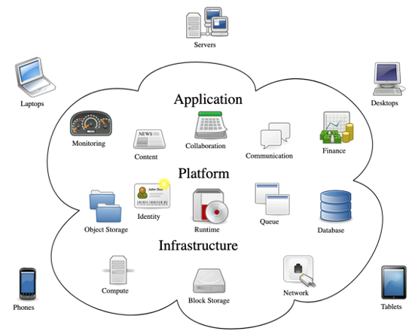
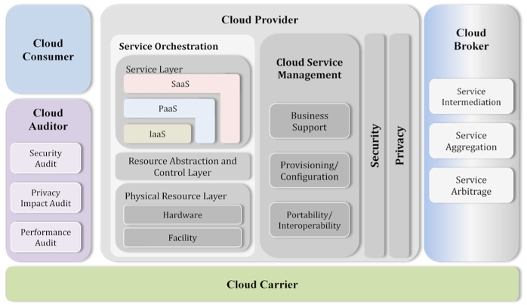
Cloud Computing
NIST Reference Architecture
There are a lot of concepts, aspects, types, … …
Some conceptual models for how it comes together.
Many applications and solutions build on all kinds of things from many clouds.
We will see examples of technology and use during the semester.

Slide 14
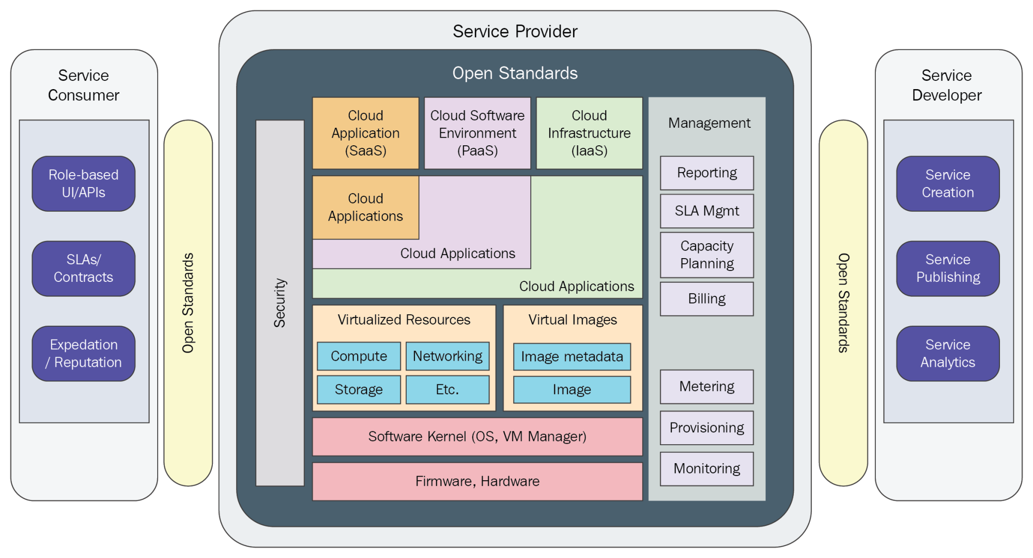

Slide 15
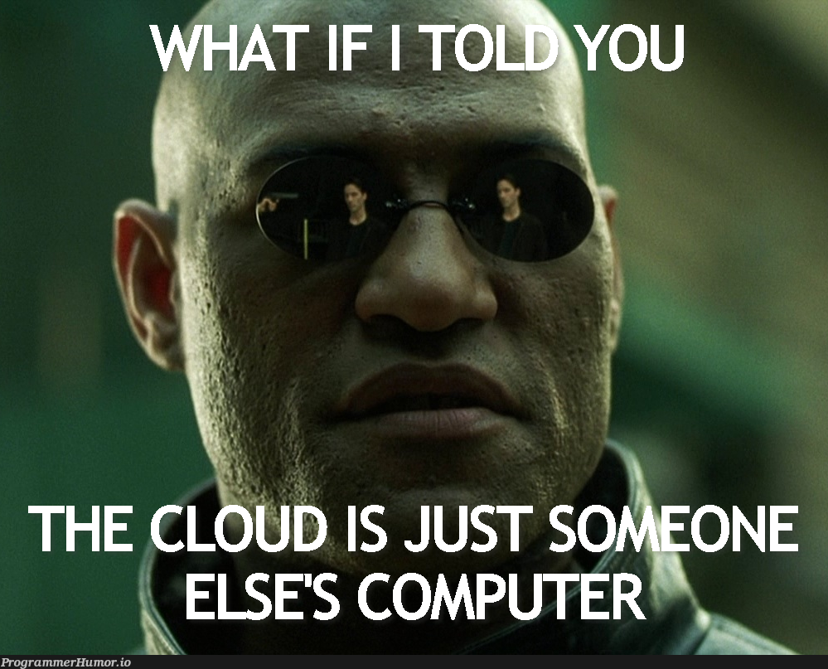
Definitions – The Best One

Slide 16
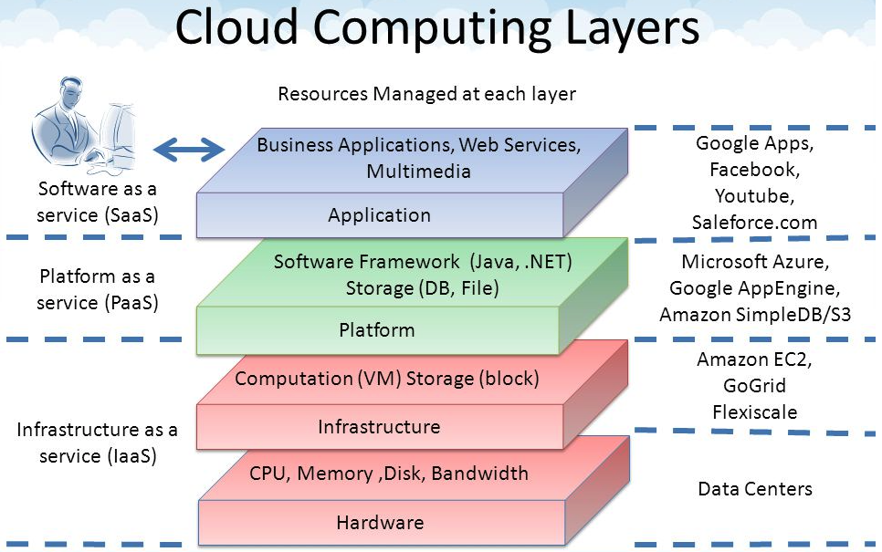
Core Layers
Our first cloud elements will
be IaaS (VMs).
Google Apps
Salesforce, Zendesk, ServiceNow, Concur, ... ...
Office 365, Trello
... ...
Google App Engine, AWS Elastic Beanstalk, ...
AWS SQS, Azure Queuing Service, Google PubSub
DynamoDB, Cosmos DB, ... ...
... ...
AWS EC2, Google Compute Engine, Azure VMs, ... ...
AWS Elastic Container Service, Azure Kubernetes, ... ...
IaaS is compute, storage, networking.
With an OS.
Delivered as a set of VMs and/or containers.

Slide 17
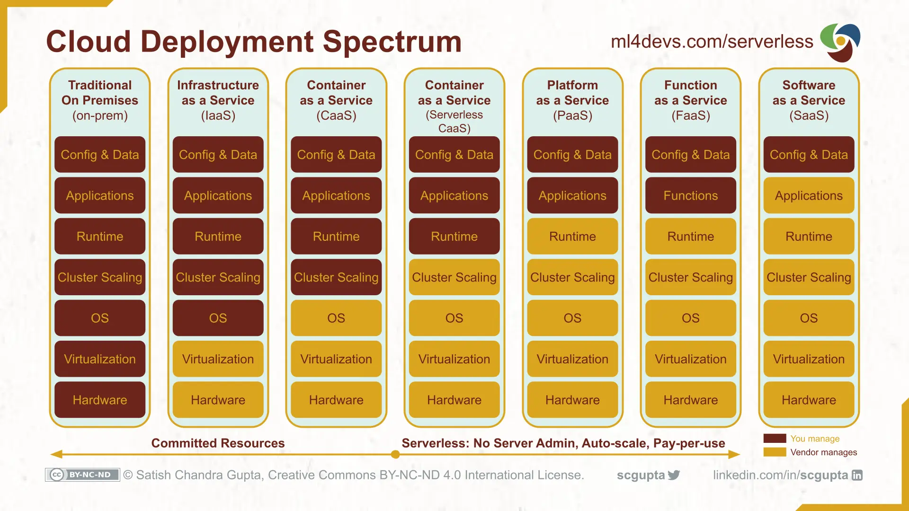
Cloud Layers

Slide 18
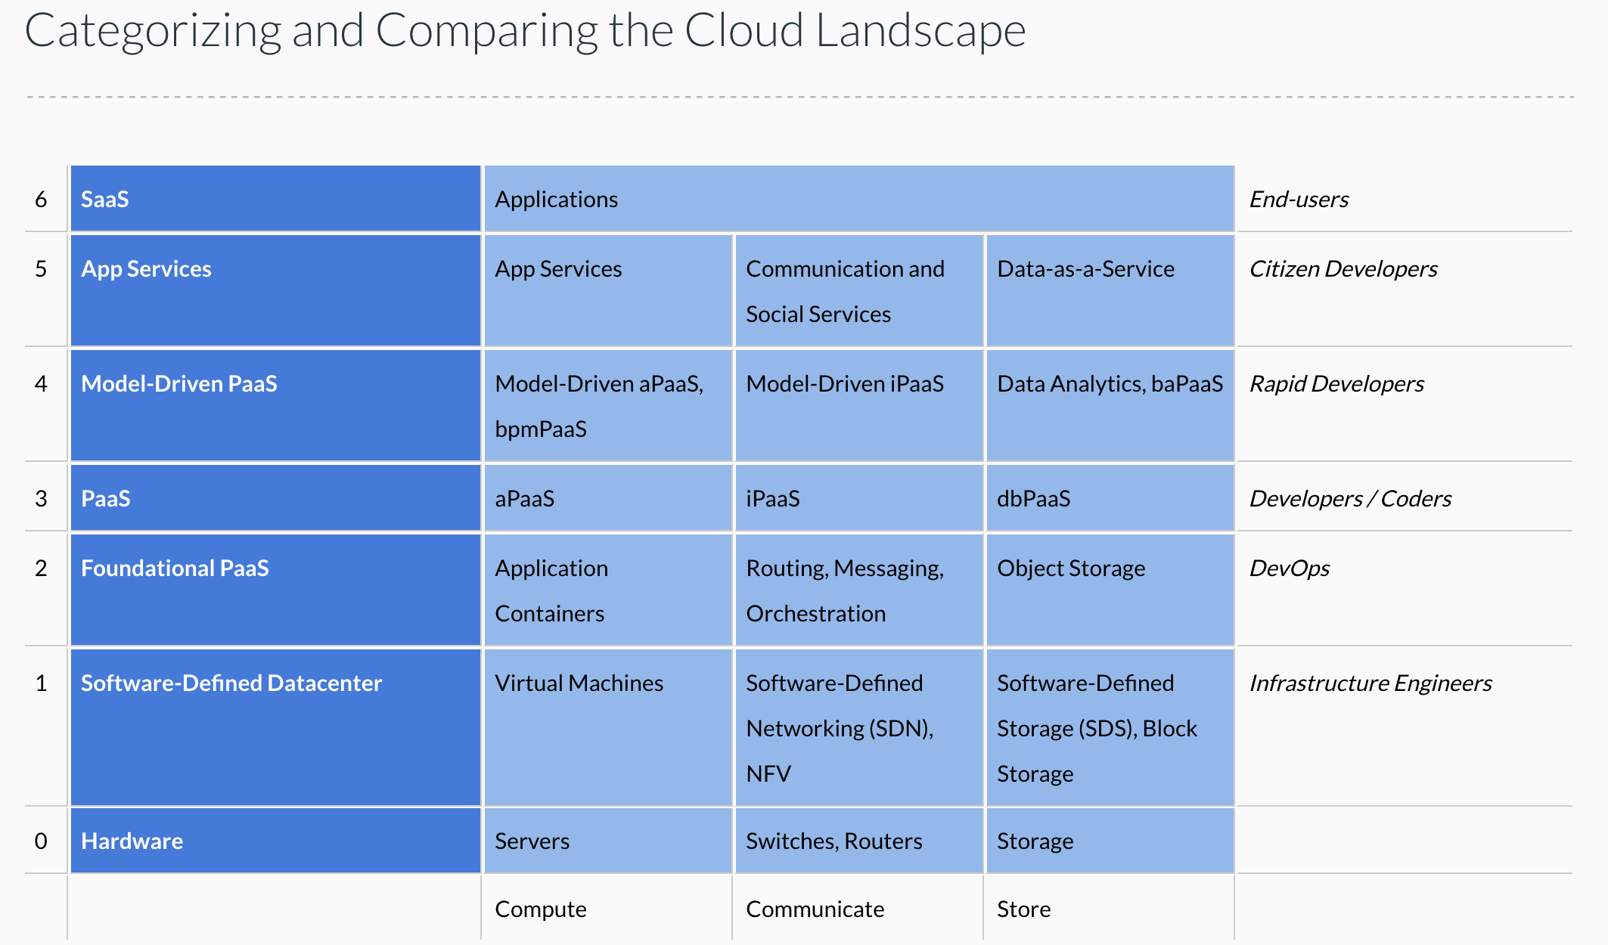
Cloud Concepts – One Perspective
http://www.theenterprisearchitect.eu/blog/2013/10/12/the-cloud-landscape-described-categorized-and-compared/

Slide 19
Why Cloud Computing?
Economy of scale:
There are fixed costs for a data center. One big data center of size N is more cost effective than N data centers.
The cloud service provider (CSP) can “buy in bulk” from HW suppliers.
The average matters:
A company must over provision resources to deal with surges in load/requests. Over provisioning by 3x is common before cloud.
The CSP can rely on averages. Not all N tenants will have surges at the same time. So, the CSP can over provision by a smaller amount than 3*N.
Elastic capacity:
Tenants do not need to over-provision.
They can “request” additional resources when there is a surge and then release. (scale up versus scale down)
Outsource non-core business functions:
A tenant does not want to manage buildings, pay water bills, … …
Buying HW, installing, configuring, monitoring and rebooting, … is a total downer.
The cloud takes over many systems and applications management and operations tasks.
Capital versus Operational Cost: Buying a house versus renting a hotel room.
On premises, non-cloud resources require capital investment, depreciation, ROI, … …
Cloud resources are rented and are operational.
There are many other reasons that you can just look up because I am too lazy to type.
Taking a cloud computing course looks really cool on your resume.

Slide 20
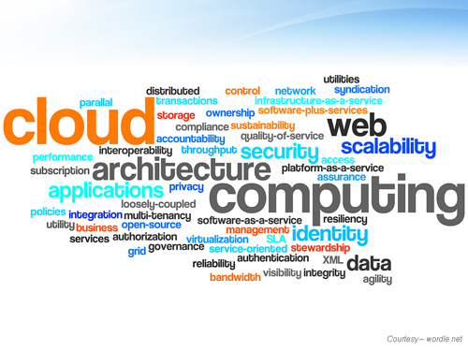
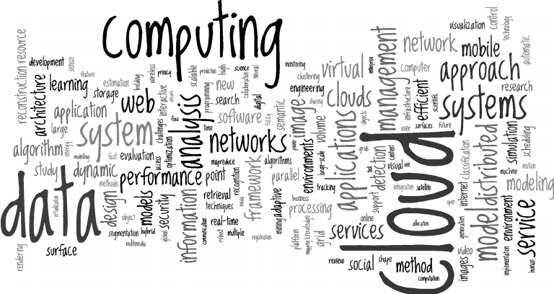
Cloud Computing Concepts
There are many, many cloud concepts, and many different perspectives on each concept.
Most cloud service providers offer their own specific versions of concepts and technology – But the core of the concept is similar.
We explore as many as we can by writing a “complex” application using the technology.
Each element in the application will be very simple, i.e. not deep application domain logic.
The overall application will have many and diverse implementations for elements.

Slide 21
Full Stack Web Application
Introduction
21 | W4153-24F-L1-Introduction-Concepts © Donald F. Ferguson, 2024

Slide 22
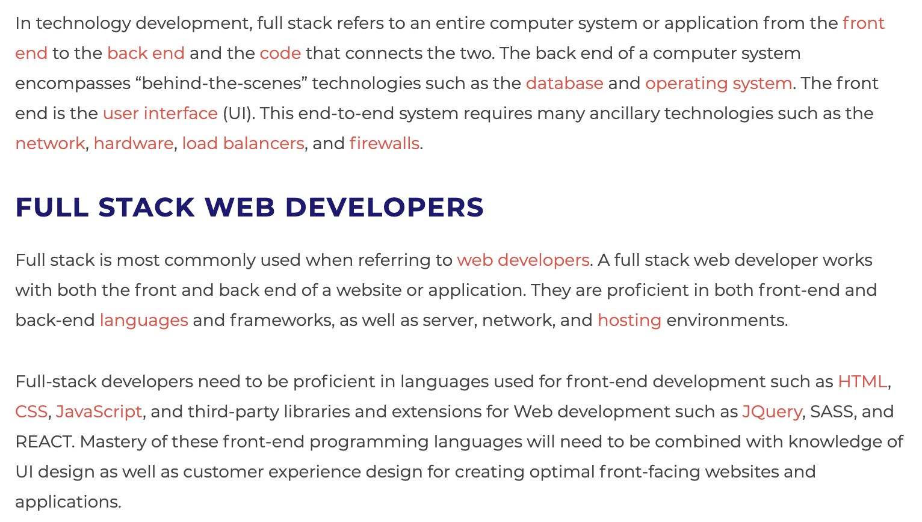
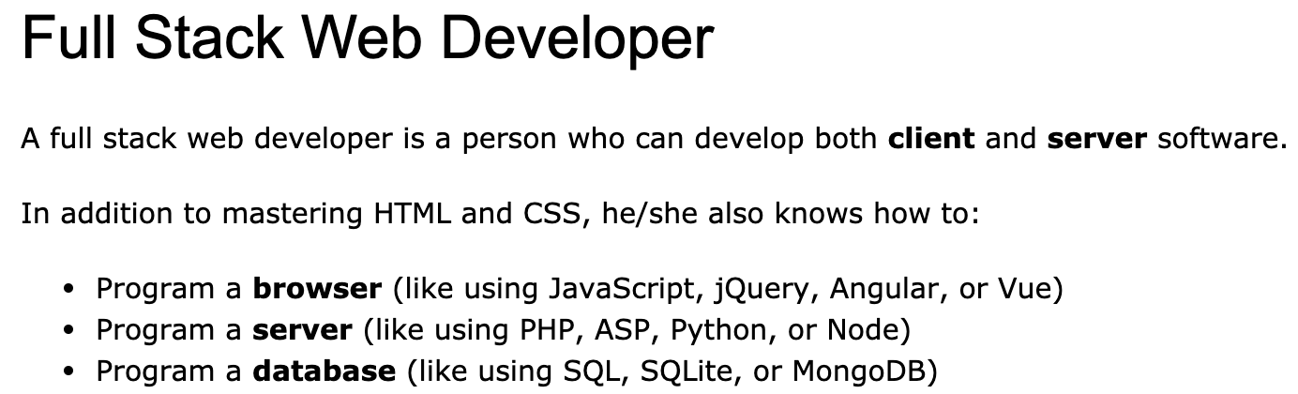
Full Stack Application
https://www.w3schools.com/whatis/whatis_fullstack.asp
There are courses that cover topics:
COMS W4153: Advanced Software Engineering
COMS W4111: Introduction to Databases
COMS W4170 - User Interface Design
This course will focus on cloud realization, microservices and application patterns, ... ...
Also, I am not great at UIs ... ... We will not emphasize or require a lot of UI work.
https://www.webopedia.com/definitions/full-stack/

Slide 23
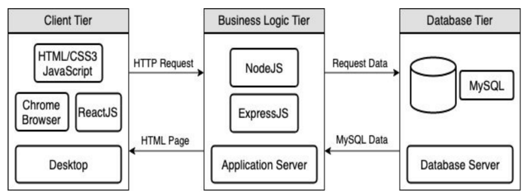
Full Stack Web Application
M = Mongo
E = Express
R = React
N = Node
I start with FastAPI and MySQL, but all the concepts are the same.
https://levelup.gitconnected.com/a-complete-guide-build-a-scalable-3-tier-architecture-with-mern-stack-es6-ca129d7df805
My preferences are to replace React with Angular, and Node with Flask.
There are three projects to design, develop, test, deploy, ... ...
Browser UI application.
Microservice.
Database.
We will initial have two deployments: local machine, virtual machine. We will ignore the database for step 1.

Slide 24
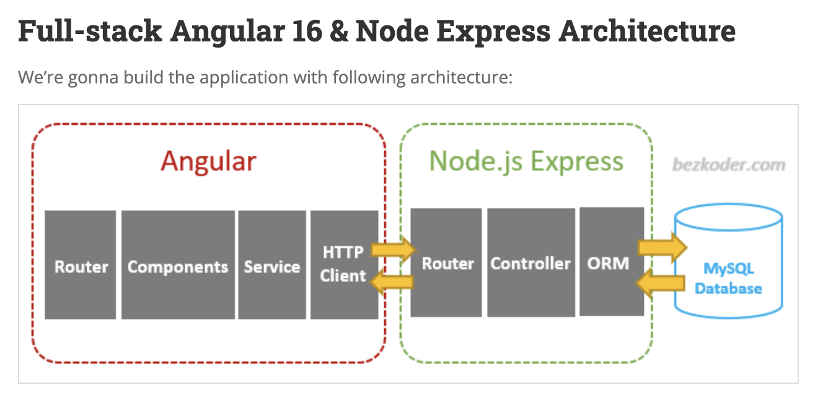
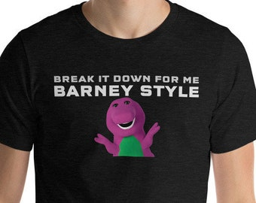
Walkthrough of a Set of Examples
I found a got set of starter examples at BezCoder.com:
Full Stack: https://www.bezkoder.com/category/full-stack/.
I will quickly walk through an example
This shows core concepts and has a lot of step-by-step guides.
I tend to use Python/FastAPI in my examples and lectures but do not provide a tutorial that ”breaks it down Barney Style.”
~/Dropbox/000/00-Current-Repos/W4153/angular-17-crud-example
~/Dropbox/000/00-Current-Repos/W4153/nodejs-express-mysql

Slide 25
Very First Step (Individual)
Create 3 GitHub projects (use any names you want) – Mine are:
W4153-P1-UI (https://github.com/donald-f-ferguson/W4153-P1-UI.git)
W4153-P1-Application (https://github.com/donald-f-ferguson/W4153-P1-Application.git)
W4153-P1-Database (https://github.com/donald-f-ferguson/W4153-P1-Database.git)
We will
Develop each project locally.
Unit test locally.
Integration test locally.
Manually deploy to the cloud platform.
Test again.

Slide 26
An Aside on Modeling
Introduction
26 | W4153-24F-L1-Introduction-Concepts © Donald F. Ferguson, 2024

Slide 27
Microservices
Introduction
27 | W4153-24F-L1-Introduction-Concepts © Donald F. Ferguson, 2024

Slide 28
Application Development Concepts
Introduction
28 | W4153-24F-L1-Introduction-Concepts © Donald F. Ferguson, 2024

Slide 29
Sprint 0 –
Get Ready for the Remainder of the course
29 | W4153-24F-L1-Introduction-Concepts © Donald F. Ferguson, 2024

Slide 30
Form Teams
Introduction
30 | W4153-24F-L1-Introduction-Concepts © Donald F. Ferguson, 2024

Slide 31
First Project (Individual)
Introduction
31 | W4153-24F-L1-Introduction-Concepts © Donald F. Ferguson, 2024

Slide 32
An Aside on “Modeling”
32 | W4153-24F-L1-Introduction-Concepts © Donald F. Ferguson, 2024

Slide 33
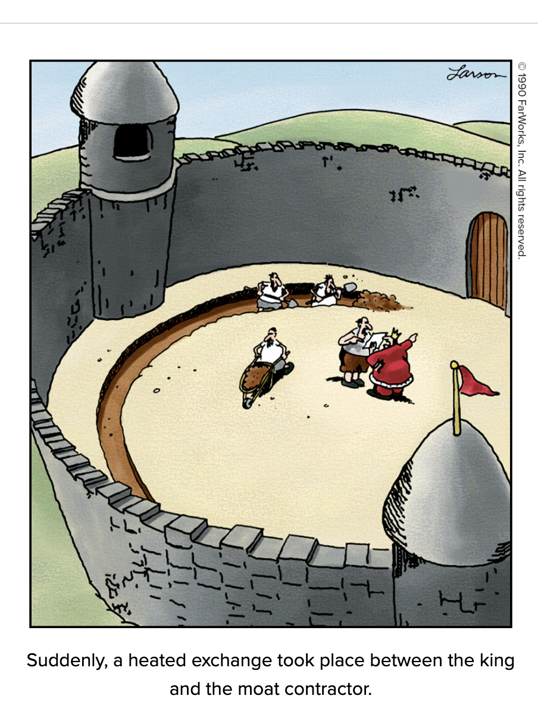
The Value of Just Enough Modeling
Weinberg's Second Law: “If builders built buildings the way programmers wrote programs, then the first woodpecker that came along would destroy civilization.”
Give your project, code, … a little upfront thought. Focus on simple steps, test and then next step.
Most students and teams build their systems and write their code like a slam poet on a triple espresso.
Just enough modeling and thought, with simple steps and frequent testing seems slow, but … … “Slow is smooth. Smooth is fast.”

Slide 34
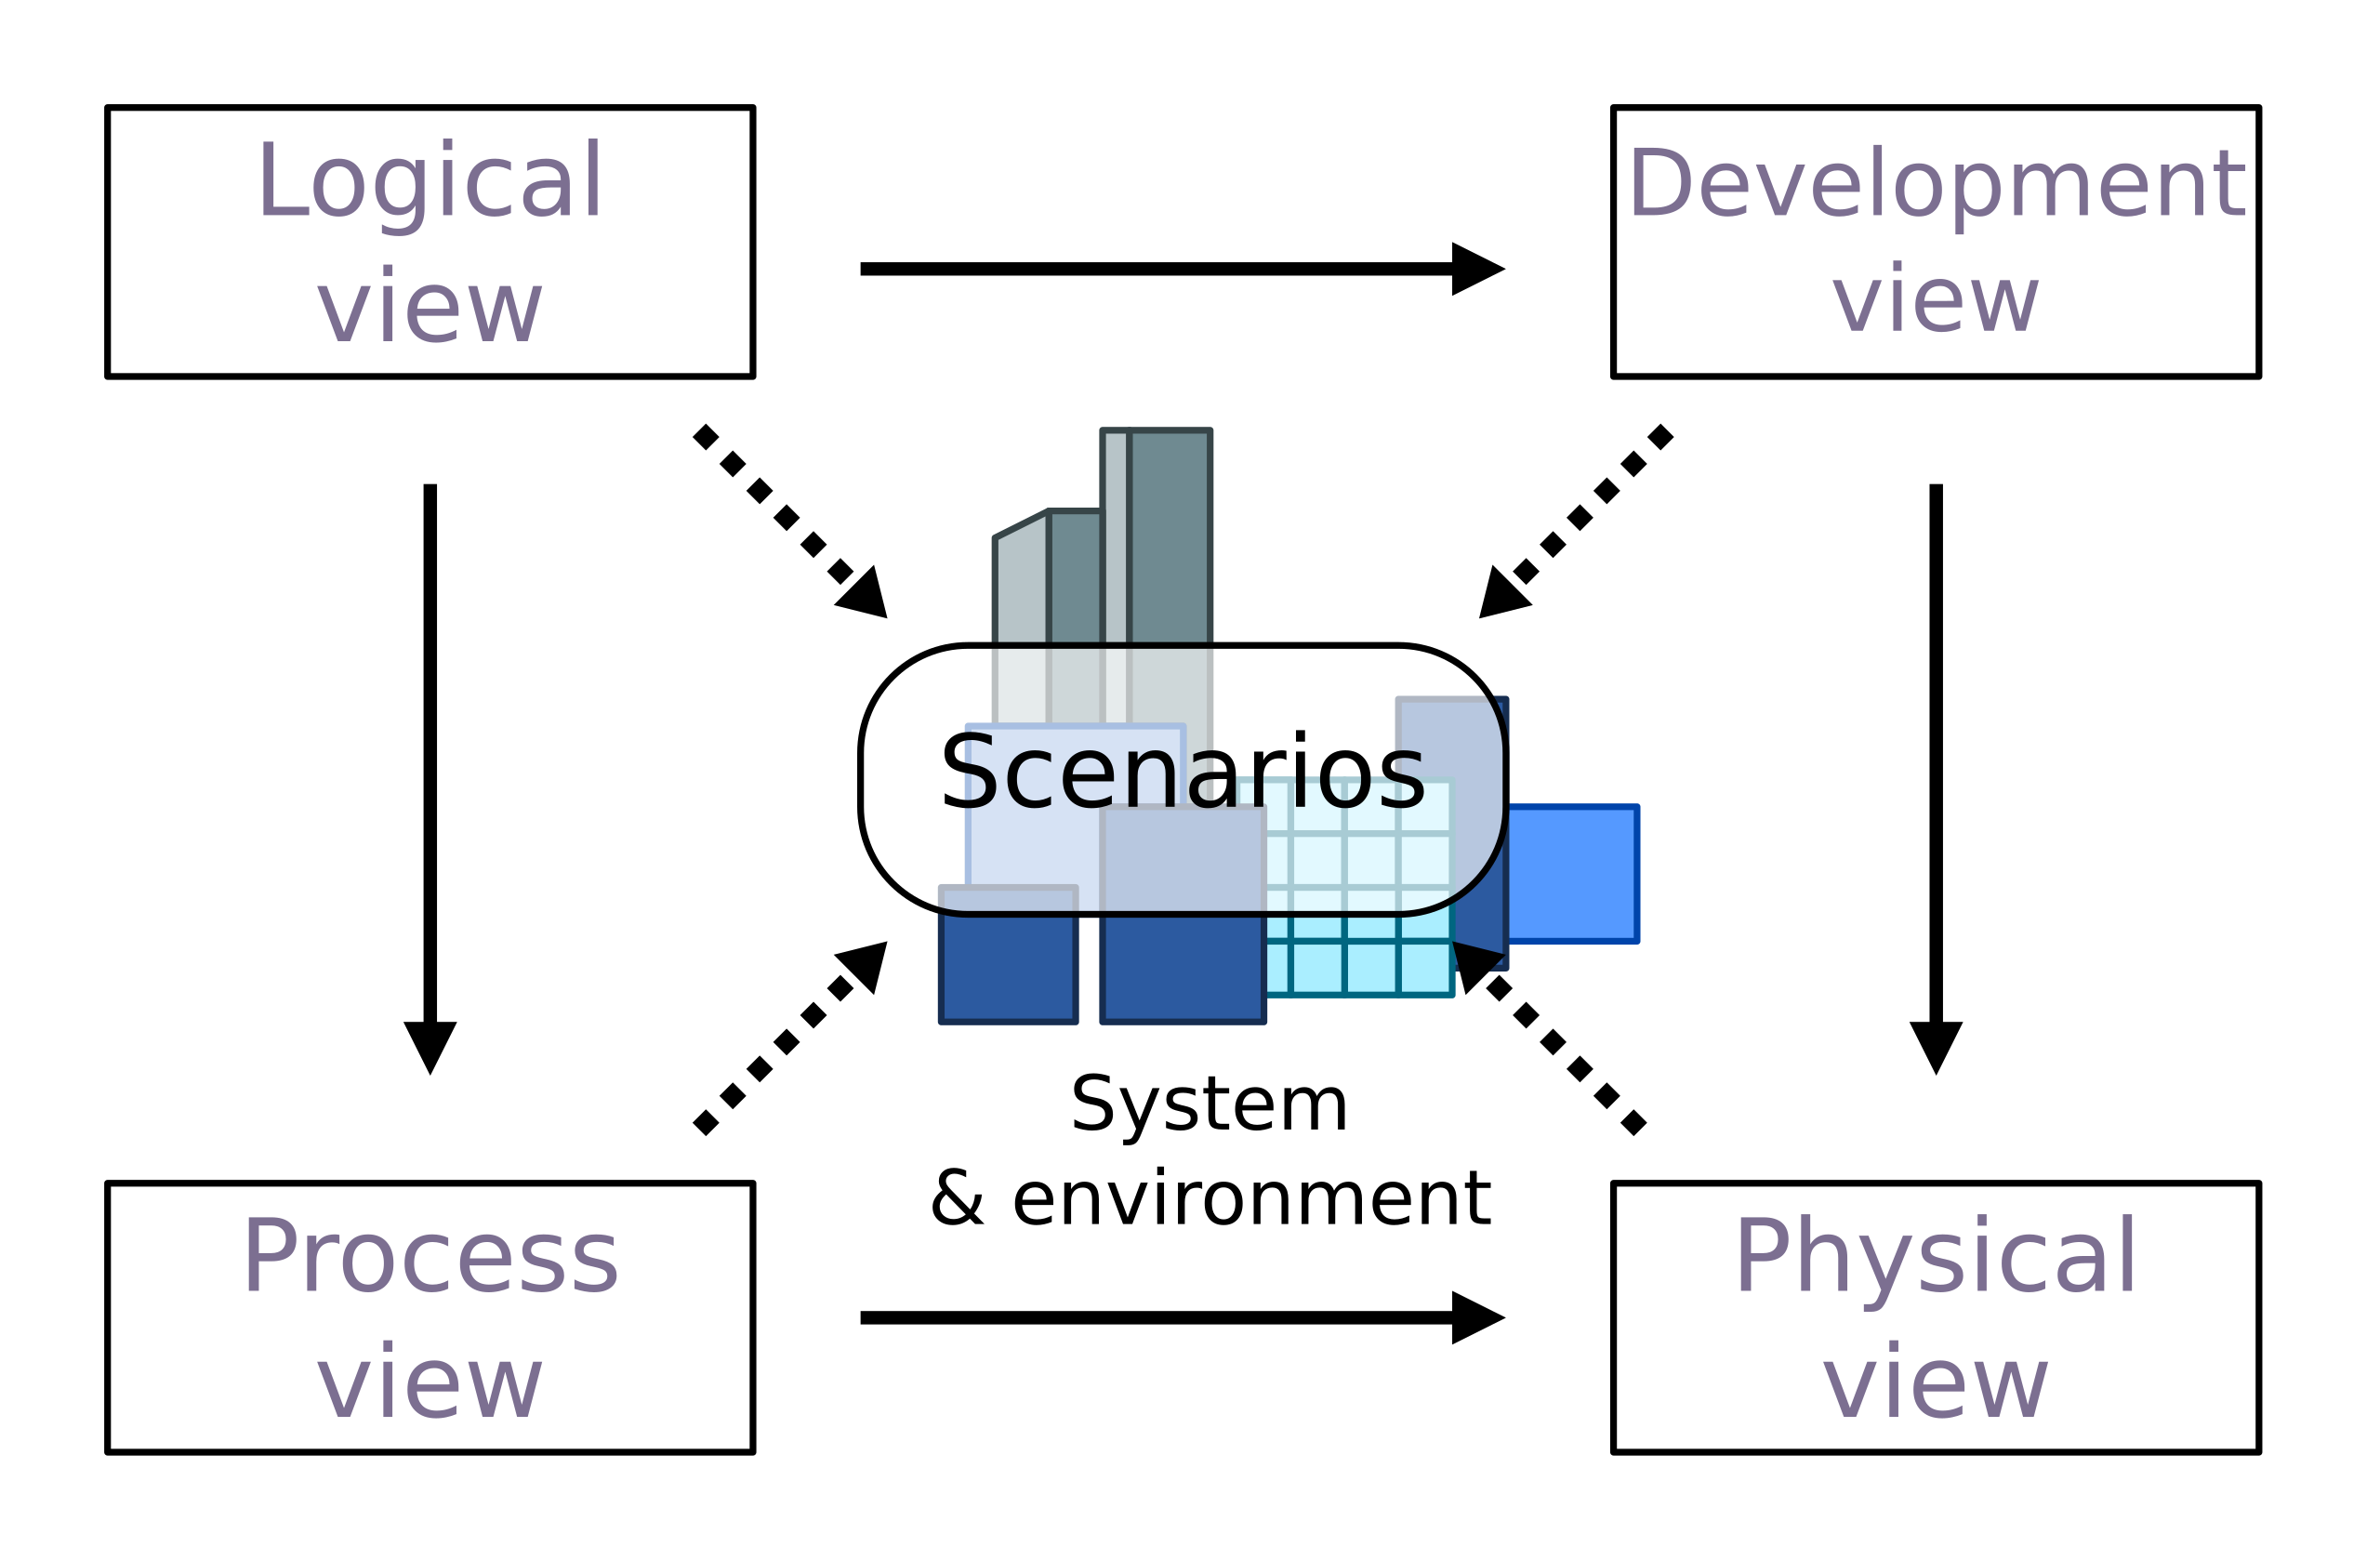
4+1 Architecture Model
I try to apply “just enough” modeling in 5 areas.
The 4+1 Architecture Model is a simple, conceptual approach.
I have a preferred ”notation” for each “view.”

Slide 35
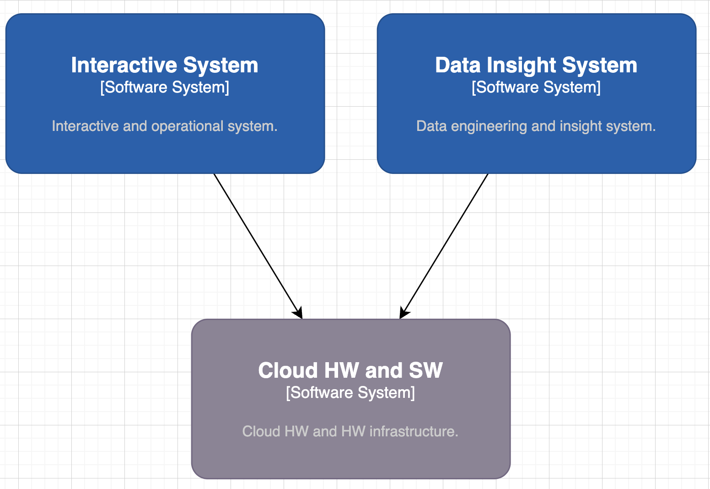
Class Project Solution – Logical View
I use C4 and UML for the logical model.
Many complex solutions have two major elements:
Operational/Interactive
Analytical/Data Analysis
We place more emphasis on interactive because there are topics courses on cloud and data.

Slide 36
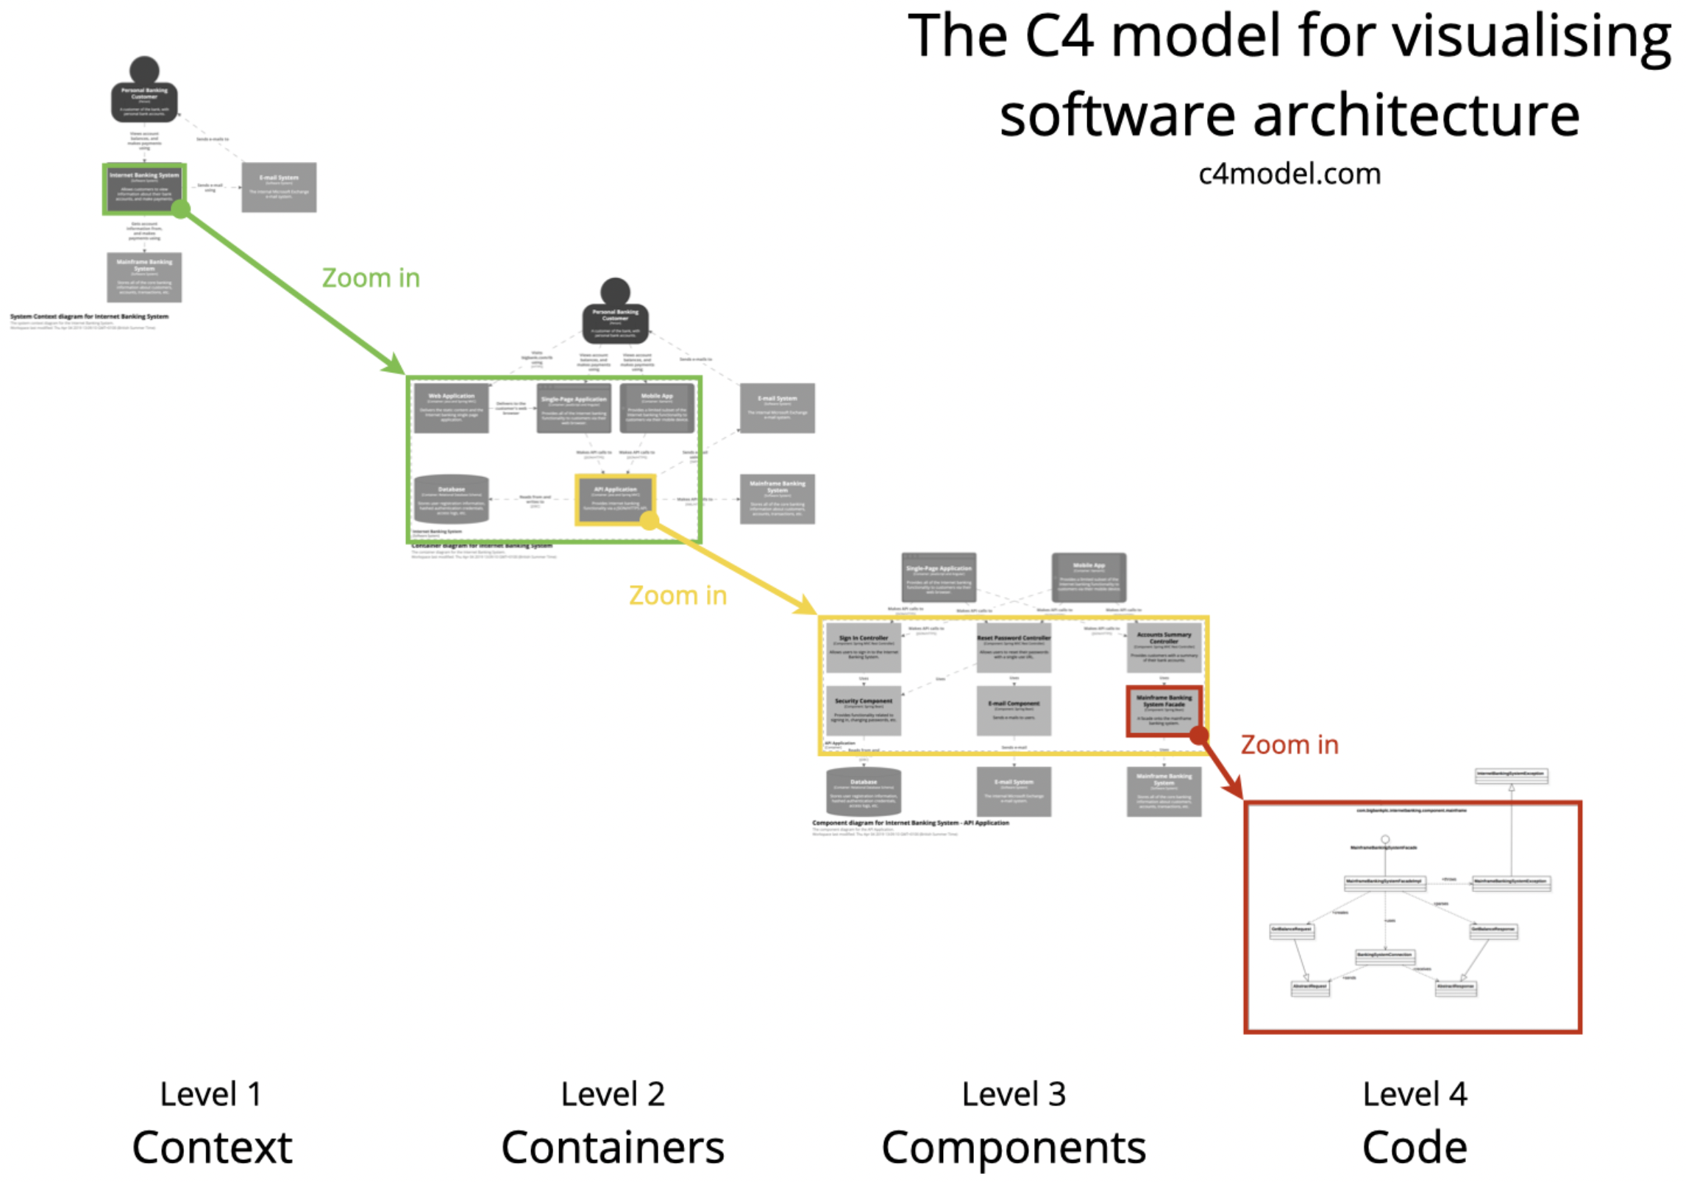
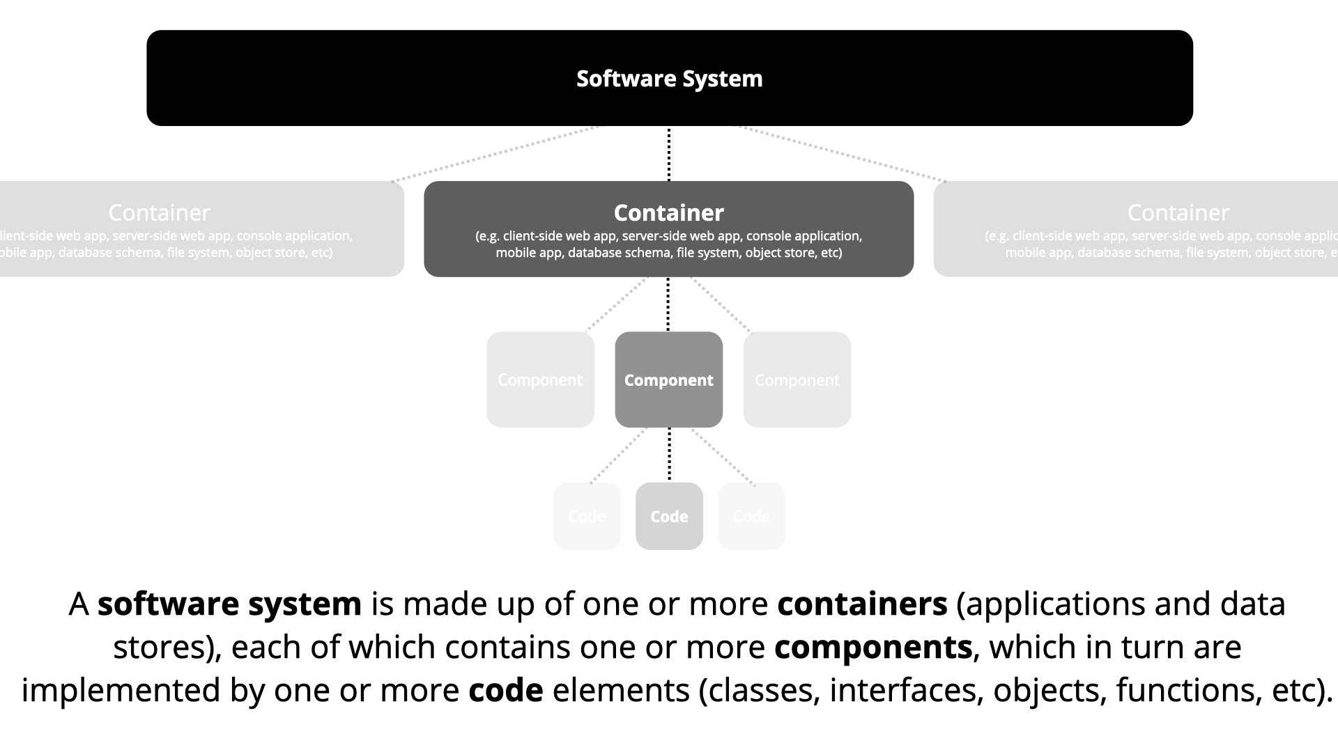
C4 Model (https://c4model.com/)
Incremental, progressive design and refinement.
Again, “just enough” to think it through and explain.

Slide 37
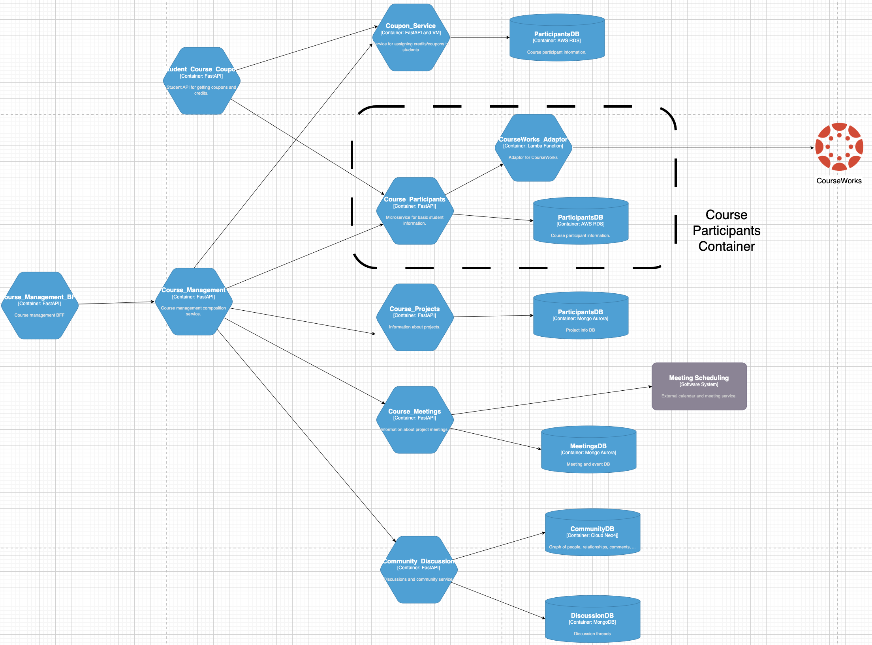
(Partial) Logical View – Interactive System
Some of the distinctions are arbitrary or in the ”eye of the beholder.”
System vs Container
Container vs Component
etc.
A container is not synonymous with a “Docker container.”
I have been in SW for 40 years and we still cannot define terms like “component.”
Just use common sense.
In general, containers in the cloud are microservices.”

Slide 38
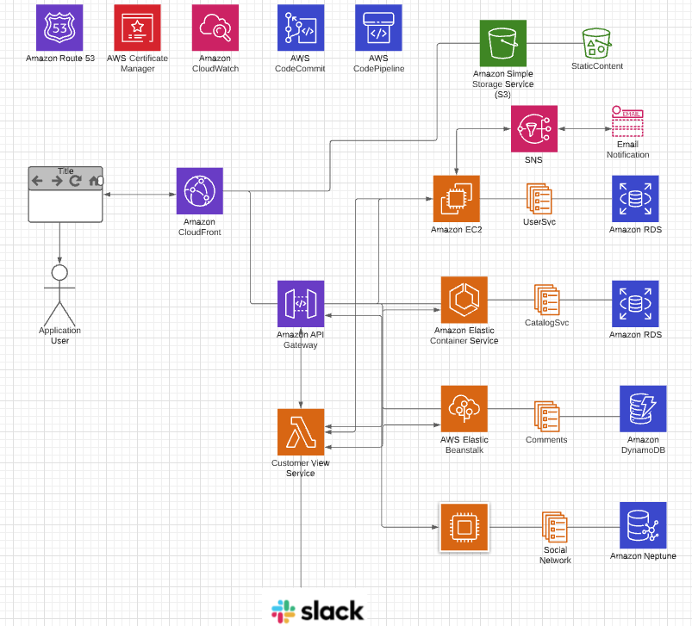
Physical View
Note: Cannot show all of the technology and connections with creating spaghetti.
Databases/Storage:
RDS
DynamoDB
MongoDB (or Document DB)
Neptune (or Neo4j)
S3
Networking/Communication:
Route 53 (DNS)
Certificate Management
CloudFront
VPC
API Gateway
Compute:
EC2
Elastic Beanstalk
Elastic Container Service (or Docker)
Lambda Functions
Integration/collaboration:
SNS, SQS
Email
Slack
Continuous Integration/Continuous Deployment:
Code Commit, Code Pipeline
Or GitHub and actions
This is directional.
I will modify and evolve.
This is AWS focused, but we will use GCP.

Slide 39
Backup
Backup and Placeholder

Slide 40
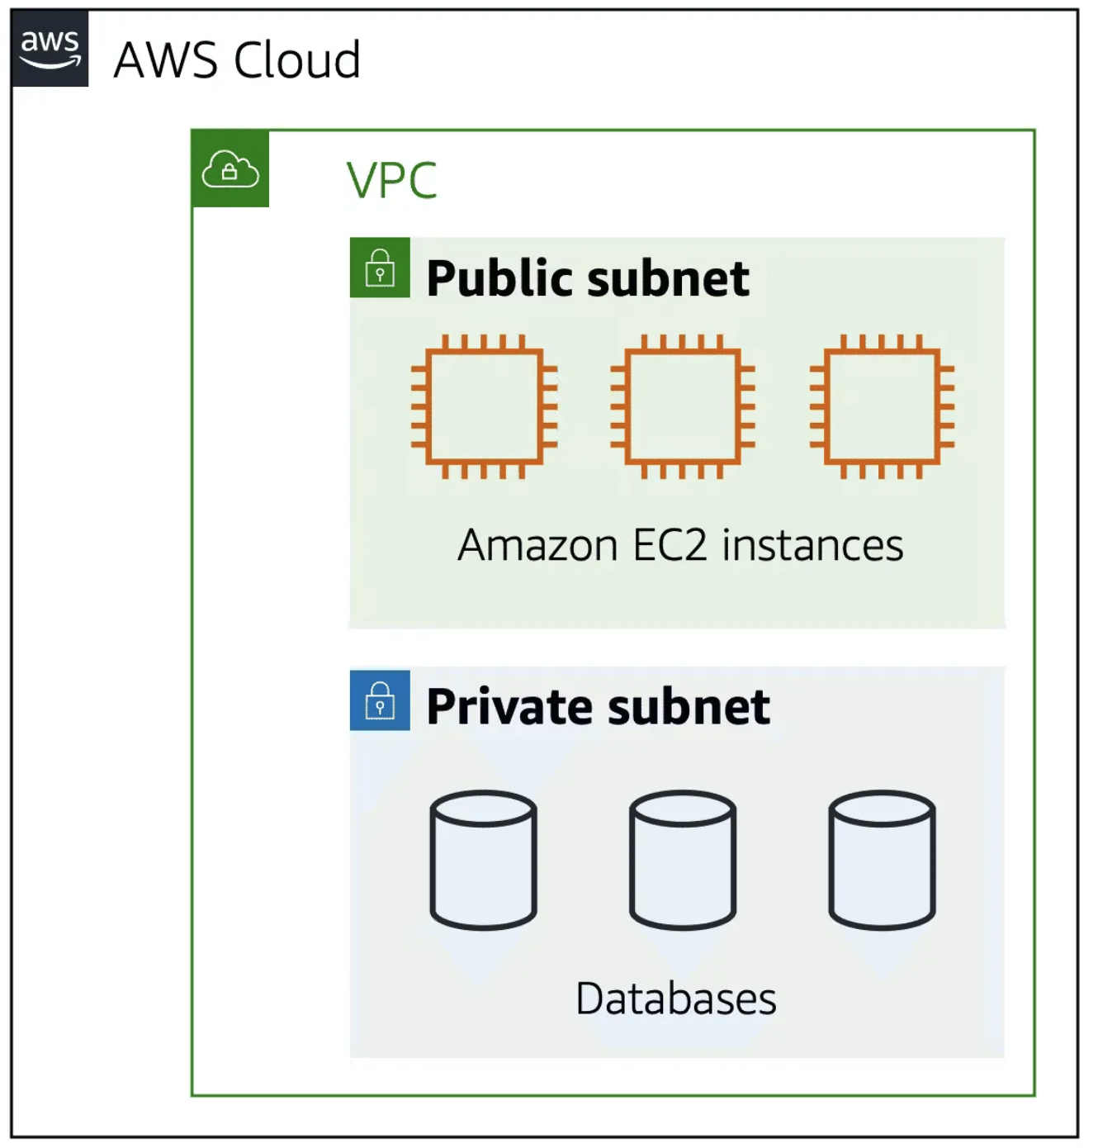
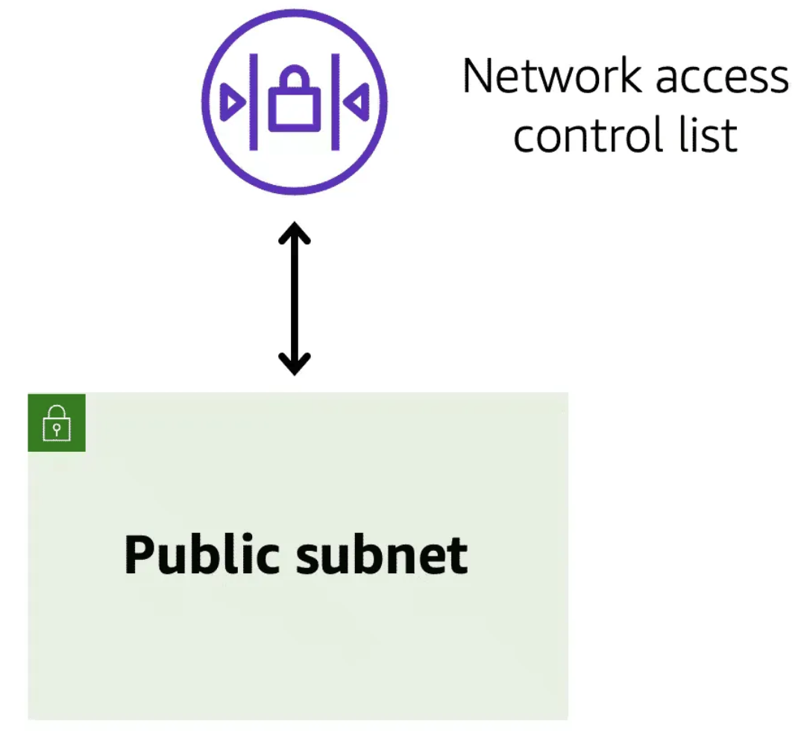
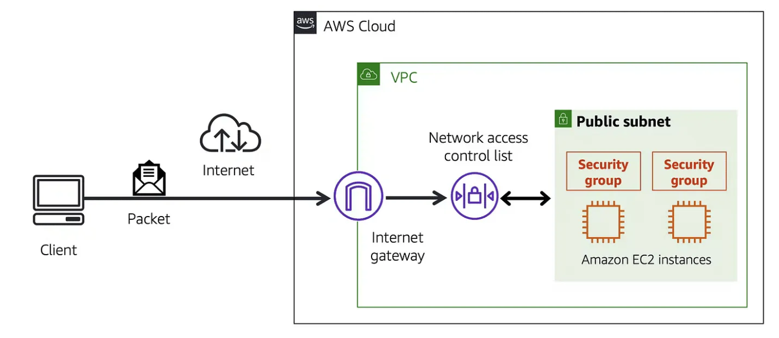
Basic Network and Security Concepts
https://jaytillu.medium.com/understanding-amazon-vpc-security-with-subnets-nacl-and-security-groups-f2baf2f21efc
Cloud network security is nested with doors for going one-level deeper: VPC → Subnet → Security group
There are inbound-outbound rules at each “door” to determine if a network packet/message can pass in or out.
Inbound rules help prevent penetration or breaking into an environment.
Outbound rules help prevent a corrupted/highjacked system for exporting/transmitting data, and unauthorized remote control.

Slide 41
W4111 Introduction to Databases:
Faculty do not manage waitlists for some courses, including W4153.
The academic admin staff in the CS Department manages the waitlist, priorities and enrollment.
You should contact advising email:
ug-advising, ms-advising, or phd-advising @cs.columbia.edu
41 | W4153-24F-L1-Introduction-Concepts © Donald F. Ferguson, 2024

Slide 42
Today’s Contents and Agenda
42 | W4153-24F-L1-Introduction-Concepts © Donald F. Ferguson, 2024

Slide 43
Contents and Agenda
Introduction
Your instructor
Course logistics, objectives, grading and overview
Overview of core concepts
Cloud “computing”
Microservices
Full-stack web application, micro-frontend
Design Patterns
Domain Driven Design
Virtual Machines, IaaS; 1 Project
Course first steps
Form teams
Individual assignment –
Set up cloud account(s)
Build and deploy ”Hello world!” application

Slide 44
Introduction
44 | W4153-24F-L1-Introduction-Concepts © Donald F. Ferguson, 2024

Slide 45
Your Instructor(s)
Introduction
45 | W4153-24F-L1-Introduction-Concepts © Donald F. Ferguson, 2024

Slide 46
Course logistics, objectives, grading overview
Introduction
46 | W4153-24F-L1-Introduction-Concepts © Donald F. Ferguson, 2024

Slide 47
Core Concepts
47 | W4153-24F-L1-Introduction-Concepts © Donald F. Ferguson, 2024

Slide 48
Cloud Computing
Introduction
48 | W4153-24F-L1-Introduction-Concepts © Donald F. Ferguson, 2024

Slide 49
Microservices
Introduction
49 | W4153-24F-L1-Introduction-Concepts © Donald F. Ferguson, 2024

Slide 50
Characteristics
Microservice architecture is like building a Lego set. Instead of one big piece, you have many smaller pieces that you put together to create something awesome.
Decomposition: Each small piece (or service) focuses on doing one specific thing really well, like a Lego piece for a car or a house.
Independence: Each piece can be built and played with on its own without affecting the others. So, you can work on building the car while your friend builds the house.
Service Communication: These pieces talk to each other using simple messages, kind of like passing notes in class.
Data Management: Each piece has its own set of instructions (or data) that it follows, so you don’t mix up the car instructions with the house instructions.
Resilience: If one piece breaks, it doesn’t ruin the whole set. You can still play with the rest of the pieces.
Scalability: If you want more cars or houses, you can just make more of those specific pieces without having to build everything from scratch.
Deployment and DevOps: Putting together the Lego set is easy because each piece is like a little container that you can easily stack and organize.
Monitoring and Observability: You keep an eye on your Lego set to make sure everything is working smoothly and fix any problems that come up.
https://medium.com/@srajsonu/designing-resilient-systems-microservices-architecture-patterns-explained-2edb52ac4f72

Slide 51
Full Stack (Web) Applications, Micro-frontend
Introduction
51 | W4153-24F-L1-Introduction-Concepts © Donald F. Ferguson, 2024

Slide 52
Full Stack Application
https://www.w3schools.com/whatis/whatis_fullstack.asp
There are courses that cover topics:
COMS W4156: Advanced Software Engineering
COMS W4111: Introduction to Databases
COMS W4170 - User Interface Design
This course will focus on cloud realization, microservices and application patterns, ... ...
Also, I am not great at UIs ... ... We will not emphasize or require a lot of UI work.
https://www.webopedia.com/definitions/full-stack/

Slide 53
Full Stack Web Application
https://levelup.gitconnected.com/a-complete-guide-build-a-scalable-3-tier-architecture-with-mern-stack-es6-ca129d7df805
My preferences are to replace React with Angular, and Node with Flask.
There are three projects to design, develop, test, deploy, ... ...
Browser UI application.
Microservice.
Database.
We will initial have two deployments: local machine, virtual machine. We will ignore the database for step 1.

Slide 54
Virtualization, Infrastructure-as-a-Service
Introduction
54 | W4153-24F-L1-Introduction-Concepts © Donald F. Ferguson, 2024

Slide 55
Design Patterns
Introduction
55 | W4153-24F-L1-Introduction-Concepts © Donald F. Ferguson, 2024

Slide 56
https://medium.com/@srajsonu/designing-resilient-systems-microservices-architecture-patterns-explained-2edb52ac4f72

Slide 57

Cloud Computing – Core Concepts
57 | E6156 - Topics in SW Engineering: Cloud Computing (F23) © Donald F. Ferguson, 2022

Slide 58
Cloud Computing
"Cloud computing is an information technology (IT) paradigm that enables ubiquitous access to shared pools of configurable system resources and higher-level services that can be rapidly provisioned with minimal management effort, often over the Internet. Cloud computing relies on sharing of resources to achieve coherence and economies of scale, similar to a public utility." (https://en.wikipedia.org/wiki/Cloud_computing)
NIST Reference Architecture

Slide 59
Core Layers
Our first cloud elements will
be IaaS (VMs).
Google Apps
Salesforce, Zendesk, ServiceNow, Concur, ... ...
Office 365, Trello
... ...
Google App Engine, AWS Elastic Beanstalk, ...
AWS SQS, Azure Queuing Service, Google PubSub
DynamoDB, Cosmos DB, ... ...
... ...
AWS EC2, Google Compute Engine, Azure VMs, ... ...
AWS Elastic Container Service, Azure Kubernetes, ... ...
IaaS is compute, storage, networking.
With an OS.
Delivered as a set of VMs and/or containers.

Slide 60
Cloud Concepts – One Perspective
http://www.theenterprisearchitect.eu/blog/2013/10/12/the-cloud-landscape-described-categorized-and-compared/

Slide 61
Motivating Sample Application (Topology)
Note: Cannot show all of the technology and connections with creating spaghetti.
Databases/Storage:
RDS
DynamoDB
MongoDB (or Document DB)
Neptune (or Neo4j)
S3
Networking/Communication:
Route 53 (DNS)
Certificate Management
CloudFront
VPC
API Gateway
Compute:
EC2
Elastic Beanstalk
Elastic Container Service (or Docker)
Lambda Functions
Integration/collaboration:
SNS, SQS
Email
Slack
Continuous Integration/Continuous Deployment:
Code Commit, Code Pipeline
Or GitHub and actions

Slide 62
Why Cloud Computing?
Economy of scale:
There are fixed costs for a data center. One big data center of size N is more cost effective than N data centers.
The cloud service provider (CSP) can “buy in bulk” from HW suppliers.
The average matters:
A company has to over provision resources to deal with surges in load/requests. Over provisioning by 3x is common.
The CSP can rely on averages. Not all N tenants will have surges at the same time. So, the CSP can over provision by a smaller amount than 3*N.
Elastic capacity:
Tenants do not need to over-provision.
They can “request” additional resources when there is a surge and then release.
Outsource non-core business functions:
A tenant does not want to manage buildings, pay water bills, … …
Buying HW, installing, configuring, monitoring and rebooting, … is a total downer.
There are many other reasons that you can just look up because I am too lazy to type.
Taking a cloud computing course looks really cool on your resume.

Slide 63
Microservices
63 | E6156 - Topics in SW Engineering: Cloud Computing (F23) © Donald F. Ferguson, 2022

Slide 64
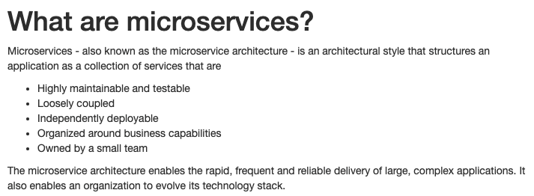
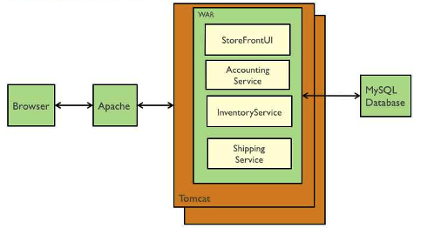
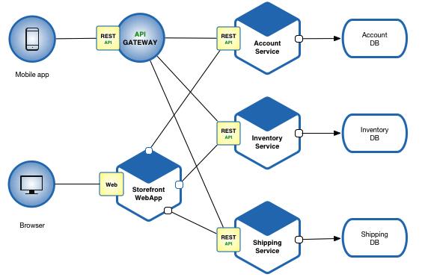
Microservices (https://microservices.io/index.html)
Microservice benefits relative to monoliths are hard to understand without having developed and maintained monoliths.
Cars are “cool.” Cars are totally, super cool if you had to go into town using a horse drawn carriage.
Microservices Architecture
Monolithic Architecture

Slide 65
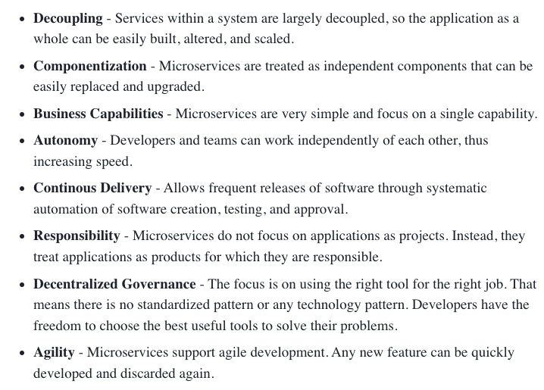
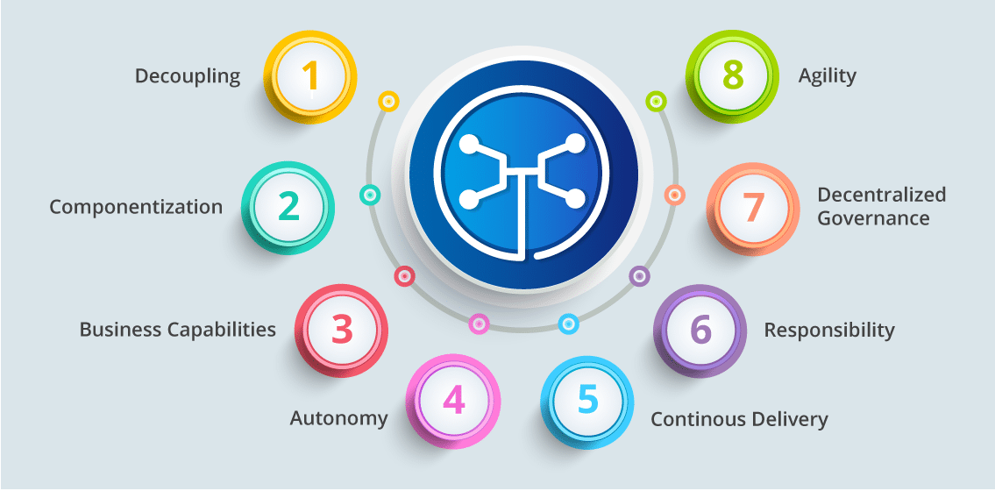
Microservice Characteristics (https://dzone.com/articles/what-is-microservices-an-introduction-to-microserv)
Microservice Characteristics

Slide 66
Design Patterns
“In software engineering, a software design pattern is a general, reusable solution to a commonly occurring problem within a given context in software design. It is not a finished design that can be transformed directly into source or machine code. Rather, it is a description or template for how to solve a problem that can be used in many different situations. Design patterns are formalized best practices that the programmer can use to solve common problems when designing an application or system.” (https://en.wikipedia.org/wiki/Software_design_pattern)
We will cover design patterns in several aspects:
SW patterns for building code “in microservices.” How do you write the code?
Architecture patterns for microservices and composition into complex solutions.
Cloud architecture patterns: how do you solve problems with cloud technology.

Slide 67
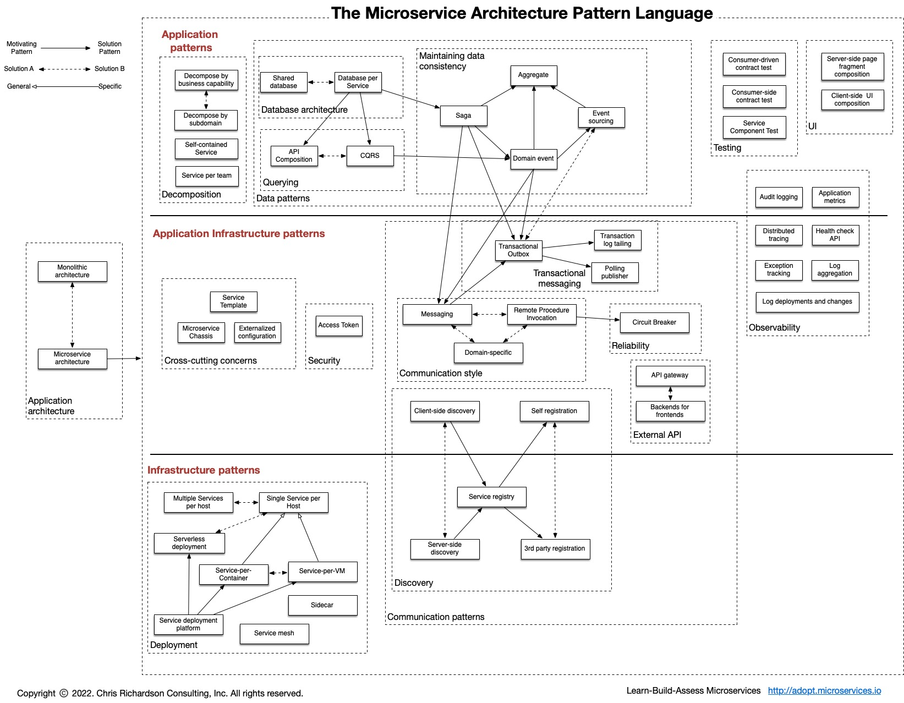
Microservice Pattern Language (One Perspective)
https://microservices.io/patterns/index.html

Slide 68
Microservice Details and Perspectives
Some sites for good, introductory overviews and more information about microservices:
https://martinfowler.com/articles/microservices.html
https://microservices.io/
https://aws.amazon.com/microservices/
What is true of any:
Mapping, classification, taxonomy, ... ...?
Technology definition, ... ...?
Enumeration of technology pros and cons ... ...?
Answers:
“... ... it is ... ... More honor'd in the breach than the observance”
If you have three subject matter experts, you have 7 conflicting opinions.
”The most dangerous thing in the world is a 2nd LT with a map.” Like any map, it is both a way of orientating yourself and a way of having a spectacular disaster because you are studying the map instead of thinking.

Slide 69
First Steps
69 | W4153-24F-L1-Introduction-Concepts © Donald F. Ferguson, 2024

Slide 70
Introduction
70 | E6156 - Topics in SW Engineering: Cloud Computing (F23) © Donald F. Ferguson, 2022

Slide 71
Course Logistics
Sessions:
Lectures:
Session is Fridays, 1:10 – 3:00 PM. The format will be:
Lecture/presentation from 1:10 to approx. 3:00
We will use extended OHs to discuss projects and topics
I can cover material much, more quickly than you can implement in projects. Typical lecture cadence will be
Lecture on new material for two lectures.
Followed by one lecture period of project discussions and reviews.
You will get experience presenting as projects teams, which is an important “soft skill.”
Instructor Office Hours:
Fridays, 8:30-10:00 AM, 3:00-5:30 CLIC
I frequently have extra office hours (online and in-person), usually around due dates for assignments.
Grading and assignments:
This is a team project class. Students form 5 person teams.
Final project’s completion of objectives determines the grade.
There are mandatory every two week project status reports and periodic reviews.

Slide 72
Resources
Course website:

Slide 73
Some Details: Assignments Structure and Objectives
No exams.
Projects:
We will form small teams and build a simple, realistic microservice/cloud application.
The teams will use a simplified version of Agile SW Development.
There will be a common core set of functionality to help you get started, e.g. user registration.
The teams can choose their project functionality -- What application do you want to build?
Teams have some flexibility on which cloud technology they use based on their interests.
Course objectives:
Practical experience with modern technology for building solutions in an agile team.
Be able to say that you have built a microservice/cloud application delivering APIs, and cite a list of technology used, e.g. IaaS, PaaS, SaaS, API Management, DBaaS, federated security, ... ...
Become a better programmer through experience with patterns and best practices. My experience has been that most students write "crappy code."
Prepare you for internships and jobs.
Have seriously cool stuff to put on your resume and discuss on interviews.

Slide 74
Course Material
Course Material:
No textbook. Textbooks become out of date in this rapidly changing area. Material would span several books.
Lecture notes and code samples on GitHub. Sample code is mostly in Flask/Python and (maybe) JavaScript/Node.js.
Course website: https://donald-f-ferguson.github.io/Topics-in-SW-Engineering-F23/
Course repo: https://github.com/donald-f-ferguson/Topics-in-SW-Engineering-F23
References to web documents and tutorials.
There will be some programming and example for UI in HTML/CSS/Angular, but this is not the focus of this course. UI/User Experience is a multi-semester course by itself.
Environment:
Required:
AWS (team) free tier account
GitHub −− project planning, light weight agile development.
Recommended:
PyCharm (free student licenses https://www.jetbrains.com/student/) and/or PyCharm
Ananconda to read Jupyter Notebooks for lectures (https://www.anaconda.com/download/#macos)
WebStorm for JavaScript (same link as PyCharm)
Collaboration environments:
Slack: Please join the channel #e6156f23 – https://join.slack.com/t/dff-columbia/shared_invite/zt-1cjbu68ty-RvaI7vLghvo0SFRFP4qbMg
We will use the Ed Discussion features, accessible through CourseWorks, for discussions.

Slide 75
Core Concepts
75 | E6156 - Topics in SW Engineering: Cloud Computing (F23) © Donald F. Ferguson, 2022

Slide 76
Cloud Computing – Core Concepts
76 | E6156 - Topics in SW Engineering: Cloud Computing (F23) © Donald F. Ferguson, 2022

Slide 77
Cloud Computing
"Cloud computing is an information technology (IT) paradigm that enables ubiquitous access to shared pools of configurable system resources and higher-level services that can be rapidly provisioned with minimal management effort, often over the Internet. Cloud computing relies on sharing of resources to achieve coherence and economies of scale, similar to a public utility." (https://en.wikipedia.org/wiki/Cloud_computing)
NIST Reference Architecture

Slide 78
Core Layers
Our first cloud elements will
be IaaS (VMs).
Google Apps
Salesforce, Zendesk, ServiceNow, Concur, ... ...
Office 365, Trello
... ...
Google App Engine, AWS Elastic Beanstalk, ...
AWS SQS, Azure Queuing Service, Google PubSub
DynamoDB, Cosmos DB, ... ...
... ...
AWS EC2, Google Compute Engine, Azure VMs, ... ...
AWS Elastic Container Service, Azure Kubernetes, ... ...
IaaS is compute, storage, networking.
With an OS.
Delivered as a set of VMs and/or containers.

Slide 79
Cloud Concepts – One Perspective
http://www.theenterprisearchitect.eu/blog/2013/10/12/the-cloud-landscape-described-categorized-and-compared/

Slide 80
Motivating Sample Application (Topology)
Note: Cannot show all of the technology and connections with creating spaghetti.
Databases/Storage:
RDS
DynamoDB
MongoDB (or Document DB)
Neptune (or Neo4j)
S3
Networking/Communication:
Route 53 (DNS)
Certificate Management
CloudFront
VPC
API Gateway
Compute:
EC2
Elastic Beanstalk
Elastic Container Service (or Docker)
Lambda Functions
Integration/collaboration:
SNS, SQS
Email
Slack
Continuous Integration/Continuous Deployment:
Code Commit, Code Pipeline
Or GitHub and actions

Slide 81
Why Cloud Computing?
Economy of scale:
There are fixed costs for a data center. One big data center of size N is more cost effective than N data centers.
The cloud service provider (CSP) can “buy in bulk” from HW suppliers.
The average matters:
A company has to over provision resources to deal with surges in load/requests. Over provisioning by 3x is common.
The CSP can rely on averages. Not all N tenants will have surges at the same time. So, the CSP can over provision by a smaller amount than 3*N.
Elastic capacity:
Tenants do not need to over-provision.
They can “request” additional resources when there is a surge and then release.
Outsource non-core business functions:
A tenant does not want to manage buildings, pay water bills, … …
Buying HW, installing, configuring, monitoring and rebooting, … is a total downer.
There are many other reasons that you can just look up because I am too lazy to type.
Taking a cloud computing course looks really cool on your resume.

Slide 82
Microservices
82 | E6156 - Topics in SW Engineering: Cloud Computing (F23) © Donald F. Ferguson, 2022

Slide 83
Microservices (https://microservices.io/index.html)
Microservice benefits relative to monoliths are hard to understand without having developed and maintained monoliths.
Cars are “cool.” Cars are totally, super cool if you had to go into town using a horse drawn carriage.
Microservices Architecture
Monolithic Architecture

Slide 84
Microservice Characteristics (https://dzone.com/articles/what-is-microservices-an-introduction-to-microserv)
Microservice Characteristics

Slide 85
Design Patterns
“In software engineering, a software design pattern is a general, reusable solution to a commonly occurring problem within a given context in software design. It is not a finished design that can be transformed directly into source or machine code. Rather, it is a description or template for how to solve a problem that can be used in many different situations. Design patterns are formalized best practices that the programmer can use to solve common problems when designing an application or system.” (https://en.wikipedia.org/wiki/Software_design_pattern)
We will cover design patterns in several aspects:
SW patterns for building code “in microservices.” How do you write the code?
Architecture patterns for microservices and composition into complex solutions.
Cloud architecture patterns: how do you solve problems with cloud technology.

Slide 86
Microservice Pattern Language (One Perspective)
https://microservices.io/patterns/index.html

Slide 87
Microservice Details and Perspectives
Some sites for good, introductory overviews and more information about microservices:
https://martinfowler.com/articles/microservices.html
https://microservices.io/
https://aws.amazon.com/microservices/
What is true of any:
Mapping, classification, taxonomy, ... ...?
Technology definition, ... ...?
Enumeration of technology pros and cons ... ...?
Answers:
“... ... it is ... ... More honor'd in the breach than the observance”
If you have three subject matter experts, you have 7 conflicting opinions.
”The most dangerous thing in the world is a 2nd LT with a map.” Like any map, it is both a way of orientating yourself and a way of having a spectacular disaster because you are studying the map instead of thinking.

Slide 88
Full Stack Application Introduction
88 | E6156 - Topics in SW Engineering: Cloud Computing (F23) © Donald F. Ferguson, 2022

Slide 89
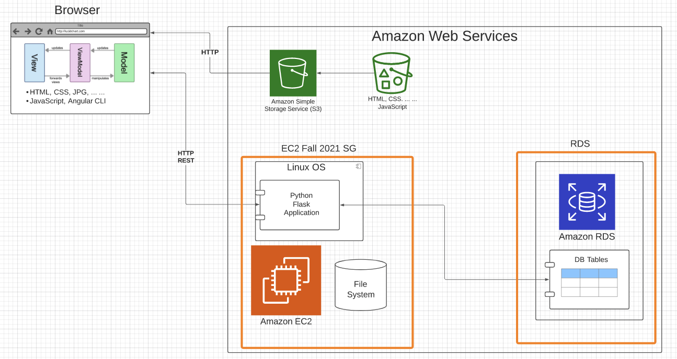
Sample Application Structure (Step 2, 3)
Browser Application:
Content: HTML, CSS, ... ...
MVVM with Angular CLI
Static Content:
S3 Bucket
Web site hosting
Server: Amazon EC2 instance (IaaS)
Linux
Web Application Server
Flask
Python
Database: Amazon RDS (DBaaS)
Simple tables
MySQL Database Server
Lifecycle:
Develop and demo locally
Deploy and configure onto AWS
Will work on CI/CD later.
Two security groups:
One for EC2 instance
One for RDS
Slightly more secure than 1 SG.
Will cover security later.

Slide 90
What is this virtual machine of which you speak? Prithee, tell me more!
90 | E6156 - Topics in SW Engineering: Cloud Computing (F23) © Donald F. Ferguson, 2022

Slide 91
Virtualization, Virtual Machines
"In computing, a virtual machine (VM) is an emulation of a computer system. Virtual machines are based on computer architectures and provide functionality of a physical computer. Their implementations may involve specialized hardware, software, or a combination." (https://en.wikipedia.org/wiki/Virtual_machine)
On mac laptop, I have:
One host operating system and HW (Mac, MacOS)
Two hypervisors (Virtual Box, VMWare Fusion)
Two guest OS: Windows 10, Debian Linux

Slide 92
Virtual Machines on Physical Machines
Note:
I cannot run Windows because
I switch to an ARM chipset.

Slide 93
Virtual Private Cloud
“A virtual private cloud (VPC) is an on-demand configurable pool of shared resources allocated within a public cloud environment, providing a certain level of isolation between the different organizations (denoted as users hereafter) using the resources. ... ...
The isolation between one VPC user and all other users of the same cloud (other VPC users as well as other public cloud users) is achieved normally through allocation of a private IP subnet and a virtual communication construct (such as a VLAN or a set of encrypted communication channels) per user.” (https://en.wikipedia.org/wiki/Virtual_private_cloud)
A virtual machine on my laptop has a virtual adaptor connected to a real network.
A virtual private cloud is a set of virtual machines connected to a virtual network.
All cloud providers support virtual private clouds with the same concepts, but with slightly different realizations and terms.

Slide 94
Some Terminology (AWS)
There are several online tutorials. Understanding some terms is useful.
AWS has the concept of a Region, which is a physical location around the world where we cluster data centers. We call each group of logical data centers an Availability Zone. Each AWS Region consists of multiple, isolated, and physically separate AZ's within a geographic area.
An Availability Zone (AZ) is one or more discrete data centers with redundant power, networking, and connectivity in an AWS Region. AZs give customers the ability to operate production applications and databases that are more highly available, fault tolerant, and scalable than would be possible from a single data center.
A VPC is a virtual private cloud, which works like a private network to isolate the resources within it.
A route table contains a set of rules, called routes, that are used to determine where network traffic is directed.
A subnet is a defined set of network IP addresses that are used to increase the security and efficiency of network communications. You can think of them like postal codes, used for routing packages from one location to another.
A network interface represents a virtual network card. The network interface displays its network interface ID, subnet ID, VPC ID, security group, and the Availability Zone that it exists in.
A security group is a set of rules that controls the network access to the resources it is associated with. Access is permitted only to and from the components defined in the security group's inbound and outbound rules.
An internet gateway is a VPC component that allows communication between instances in your VPC and the internet.
A VPC endpoint enables you to privately connect your VPC to supported AWS services without using public IP addresses.
All clouds have similar concepts but with different names.

Slide 95
Let’s Build our First VPC
Well, actually, let’s not do that for now.
We are just going to create our first virtual machine.
But,
The virtual machine is in my “default” VPC.
Setting up and using the VM requires understanding some of the concepts.
We can mostly just use the EC2 wizard for now.
I am going to set up a VM to host our first cloud application
I will deploy the application and supporting SW.
Basic tasks:
Configure and deploy VM, SSH credentials, security group rules.
Install supporting software: Python, MySQL.
Run “Hello World” test.
But first, let’s walk through the application structure and implementation.

Slide 96
Hands on Demo and Code Reviews
96 | E6156 – Topics in SW Engineering: Cloud Computing: Lecture 1 – Introduction, Course Overview, Concepts © Donald F. Ferguson, 2022

Slide 97
Code Review and Demo
Code review:
No browser UI application for now.
Walkthrough code in ~/Dropbox/000-NewProjects/E6156F23/first_microservice
Show access from browser and Postman
Introduce content-type and a browser being an application that calls APIs.
Other applications examples: curl, Postman, test program in project
Walkthrough and demo:
Sign up for AWS.
Two critical rules:
Use the free tier when you can.
Shutdown your resources when not using them.
Create and use a VM:
Create the VM and expose endpoints.
Install prereqs.
Clone a GitHub project.
requirements.txt
Test the VM from the console.
Test the VM from your laptop.
Shutdown and delete everything.

Slide 98
Assignment/Project 1
98 | E6156 – Topics in SW Engineering: Cloud Computing: Lecture 1 – Introduction, Course Overview, Concepts © Donald F. Ferguson, 2022

Slide 99
Assignment 1/Project Step 1
Every person Individually:
Create an AWS account.
Configure laptop
IDE:
Get JetBrains student license.
Install PyCharm
Optional:
Install WebStorm
Install DataGrip
Install Anaconda (new environment)
Postman
Create a GitHub project.
Develop, test, commit and push a simple FastAPI application. There are lot’s of starter templates. Implement the routes
/
/hello{name}
/hello_text/{name}
/students
Create and configure an EC2 instance. Clone project and repeat the tests.
Group: Form 5-7 student team.
Each team must have a designated communication focal point. The professor and TAs will use to communicate with teams.
The focal point must enter the information on the Google form for the team: https://forms.gle/t1wu8a3DZPJYnEks5
Create a GitHub Project for the course, and add team members: https://docs.github.com/en/issues/planning-and-tracking-with-projects/creating-projects/creating-a-project
Defined this weekend.

